Slide 1
Memory Management Simulator using C
Guided By:
Dr . V. Jayasudha
Done BY:
Jatin Vijaykumar(192412047)
Nithesh . Y(192521305)
1

Slide 2
INTRODUCTION
Memory management decides how available memory blocks are assigned to processes.
This project provides a simple C-based simulator for dynamic memory allocation.
The implemented allocation strategy is the First-Fit algorithm.
Users provide memory-block sizes and process sizes through command-line arguments.
The simulator displays which block receives each process and identifies unallocated processes.
2

Slide 3
PROBLEM STATEMENT
Manual calculation of memory allocation becomes difficult when several processes compete for limited blocks.
A simulator is required to demonstrate allocation decisions clearly and consistently.
The system should accept block/process data, apply an allocation rule, update remaining space, and report the result.
The project focuses on understanding the logic behind memory allocation rather than building an operating-system memory manager.
3

Slide 4
OBJECTIVES
Implement a memory management simulator using standard C.
Accept multiple memory-block sizes and process sizes as input.
Parse comma-separated input values using string tokenization.
Implement First-Fit allocation using arrays and nested loops.
Update the remaining capacity of allocated memory blocks.
Display allocation status for every process.
4

Slide 5
SYSTEM ARCHITECTURE / WORKING FLOW
Input Blocks
100,500,200...
Input Processes
212,417,112...
Parse Tokens
strtok() + atoi()
First-Fit Engine
Search first suitable block
Update Block
Remaining capacity
Output
Allocated / Not Allocated
6

Slide 6
MODULE 1 — INPUT & MEMORY DATA PARSING
The main() function receives block and process data through argv[].
strtok() separates comma-delimited values into individual tokens.
atoi() converts each token from text into an integer.
Blocks are stored in blocks[50]; processes are stored in processes[50].
The counters m and n track the number of blocks and processes.
char *token = strtok(argv[1], ",");
while (token != NULL) {
blocks[m++] = atoi(token);
token = strtok(NULL, ",");
}
7

Slide 7
MODULE 2 — FIRST-FIT MEMORY ALLOCATION
Each process is checked against memory blocks from the first block onward.
The first block whose remaining size is sufficient is selected.
The allocated process size is subtracted from that block.
The search stops immediately after the first suitable block is found.
If no block is large enough, the process remains unallocated.
if (blockSize[j] >= processSize[i]) {
allocation[i] = j;
blockSize[j] -= processSize[i];
break;
}
8

Slide 8
FIRST-FIT ALGORITHM
Step 1: Initialize allocation for every process to -1.
Step 2: Select the next process.
Step 3: Scan memory blocks from the beginning.
Step 4: If block size ≥ process size, allocate the process there.
Step 5: Reduce the selected block's remaining capacity.
Step 6: Move to the next process; otherwise report Not Allocated after all blocks are checked.
9

Slide 9
KEY CODE LOGIC
void firstFit(int blockSize[], int m, int processSize[], int n) {
int allocation[n];
for (int i = 0; i < n; i++)
allocation[i] = -1;
for (int i = 0; i < n; i++) {
for (int j = 0; j < m; j++) {
if (blockSize[j] >= processSize[i]) {
allocation[i] = j;
blockSize[j] -= processSize[i];
break;
}
}
}
}
10

Slide 10
SAMPLE INPUT
Memory blocks:
100,500,200,300,600
Processes:
212,417,112,426
Command-line form:
memorysim.exe "100,500,200,300,600" "212,417,112,426"
The simulator parses both comma-separated lists before starting allocation.
11

Slide 11
SAMPLE OUTPUT & INTERPRETATION
=== MEMORY SIMULATION ===
Process No Process Size Block No
1 212 2
2 417 5
3 112 2
4 426 Not Allocated
Process 1 uses Block 2; its remaining capacity becomes 288.
Process 2 uses Block 5; its remaining capacity becomes 183.
Process 3 fits into the remaining space of Block 2; 176 remains.
Process 4 needs 426 units, so no remaining block can accommodate it.
12

Slide 12
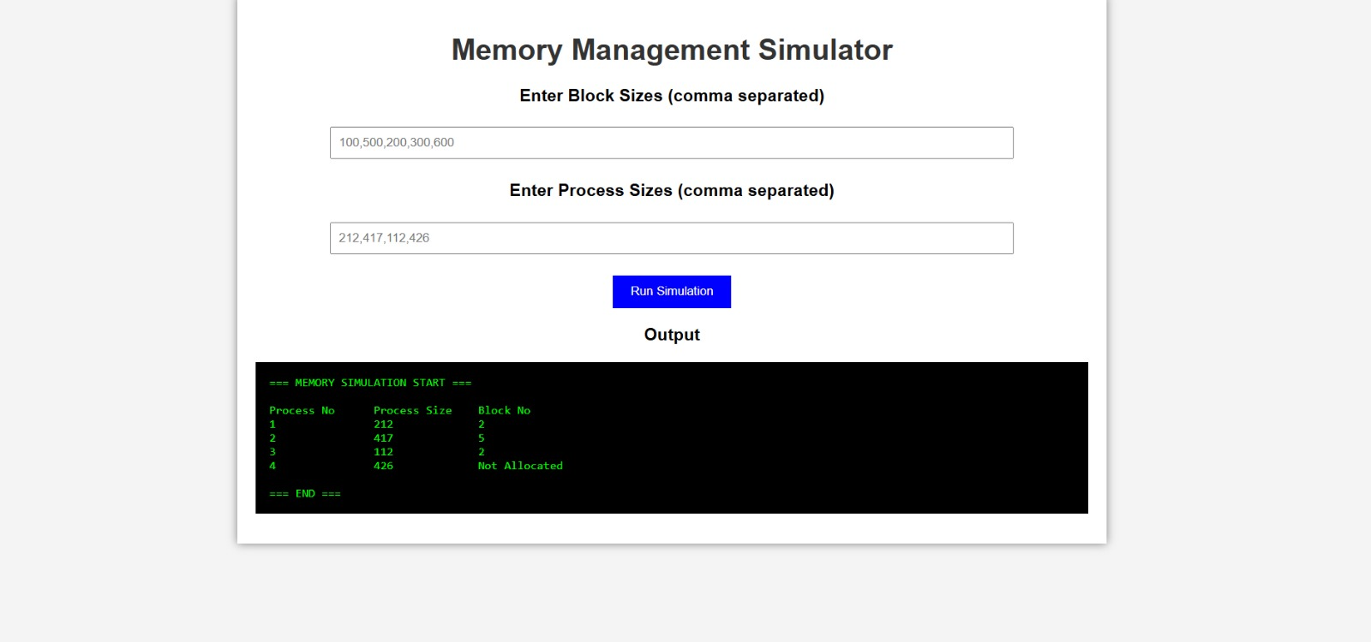
OUTPUT
13

Slide 13
DATA FLOW & MEMORY STATE UPDATE
Input arrays represent the initial available memory and requested process sizes.
During allocation, blockSize[] is modified in-place to store remaining capacity.
allocation[] records the selected block index for each process.
An allocation value of -1 means the process could not be allocated.
The final table is generated from processSize[] and allocation[].
13

Slide 14
ADVANTAGES & CURRENT LIMITATIONS
Advantages
Simple and easy-to-understand First-Fit logic
Fast for small inputs
Clear allocation table
Uses standard C libraries
Useful for OS/memory-management learning
Current Limitations
Only First-Fit is implemented
Input validation is minimal
Requires command-line arguments
No graphical interface
No internal comparison with Best-Fit / Worst-Fit
15

Slide 15
FUTURE ENHANCEMENTS
Add Best-Fit and Worst-Fit allocation algorithms for comparison.
Add a menu-driven interface instead of only command-line input.
Add input validation and clearer error messages for missing or invalid arguments.
Display memory blocks graphically before and after allocation.
Add fragmentation analysis and allocation-efficiency statistics.
Extend the simulator with deallocation and process termination.
16

Slide 16
CONCLUSION
The project successfully demonstrates dynamic memory allocation using the First-Fit strategy.
The C program accepts block/process data, performs allocation, updates remaining block capacity, and reports the final status.
The implementation gives a practical view of how allocation decisions affect available memory.
The current version is intentionally compact and can be extended into a multi-algorithm memory-management simulator.
.
17

Slide 17
THANK YOU

